Slide 1

Graduation Project
Implementing VPN Solutions With FortiGate
Page 1

Slide 2

Page 2

Slide 3
THYNK UNKIMITED
TYPES OF VPNs
Remote Access VPN
Site-to-Site VPN
Allows individual users to connect to a private network remotely over the internet.
Uses:
Employees working from home
Students accessing university resources
Secure access to company files and applications
Connects two networks together over the internet (network-to-network).
Uses:
Connecting branch offices with HQ
Linking data centers
Secure internal communication between company locations
SSL VPN
IPsec VPN
Accessible through a browser (uses HTTPS). No special software needed.
Uses:
Students logging into portals
Employees accessing specific apps remotely
Quick remote access with minimal setup
Uses IPsec for encrypted communication between endpoints or networks.
Uses:
Site-to-site VPNs
Client-to-site VPNs
High-security environments
Page 4

Slide 4
IPsec Site-to-Site VPN
Established between two FortiGate devices to connect separate LAN networks over
the internet. Configuration included Phase 1 and Phase 2 parameters, firewall
policies, and static routes to ensure seamless encrypted communication.
Project Description
SSL VPN Configuration
Configured SSL VPN for remote access, allowing users to connect safely to the
internal network through encrypted HTTPS connections. User authentication, IP
pools, and security policies were applied to control and monitor access efficiently.
Connectivity was tested using FortiClient in both web and tunnel modes.
The project focuses on designing and implementing secure Virtual Private Network (VPN)
solutions using FortiGate firewalls to enable both remote user access and secure
communication between different network sites.
Testing
Ping and file transfer operations confirmed stable, secure connectivity. Both VPN
types provide secure, efficient, and reliable access for remote users and inter
branch communication.
Page 3

Slide 5
SSL VPN Configuration Documentation
Page 2

Slide 6
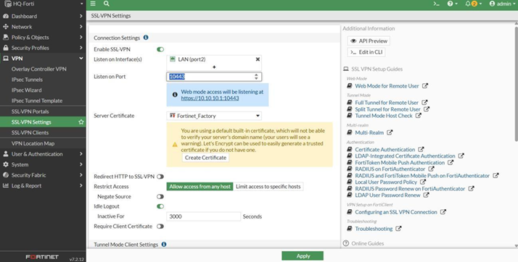
HQ FortiGate SSL VPN Configuration
Step 1 - In SSL VPN Settings
VPN → SSL-VPN Settings Configuration
• Listen on Interface: port2 (LAN)
• Listen on Port: 10443 (HTTPS)
• Server Certificate: Fortinet_Factory
• Idle Timeout: 3000 seconds
• Tunnel Mode IP Pools: SSLVPN_TUNNEL_ADDR1 (10.212.134.200 - 10.212.134.210)
• IPv6 Pools: SSLVPN_TUNNEL_IPv6_ADDR1 (fdff:ffff::/120)
• Default Portal: full-access
Page 2

Slide 7
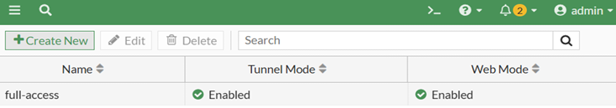
HQ FortiGate SSL VPN Configuration
Step 1 - In SSL VPN Settings
Portal Settings (full-access):
• Tunnel Mode: Enabled
• IPv6 Tunnel Mode: Enabled
• Web Mode: Enabled
• IP Pools: SSLVPN_TUNNEL_ADDR1
Page 2

Slide 8
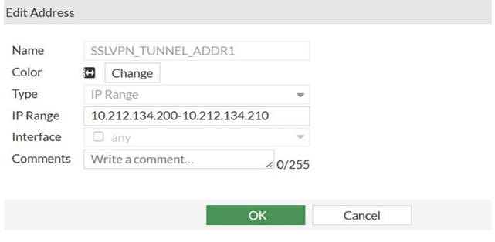
HQ FortiGate SSL VPN Configuration
Step 2: Create IP Pool for SSL VPN Users
• Name: SSLVPN_TUNNEL_ADDR1
• Type: IP Range
• Start IP: 10.212.134.200
• End IP: 10.212.134.210
Page 2

Slide 9
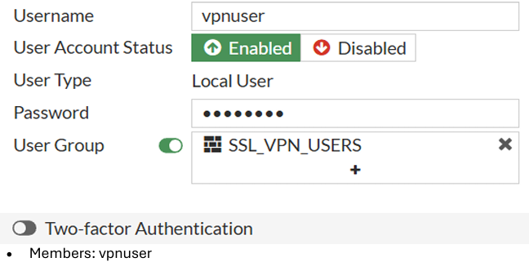
HQ FortiGate SSL VPN Configuration
Step 3: Create User Account
• Username: vpnuser
• Type: Local User
• Password: (Set secure password)
Step 4: Create User Group
• Name: SSL_VPN_USERS
• Type: Firewall
• Status: Enabled
Page 2

Slide 10
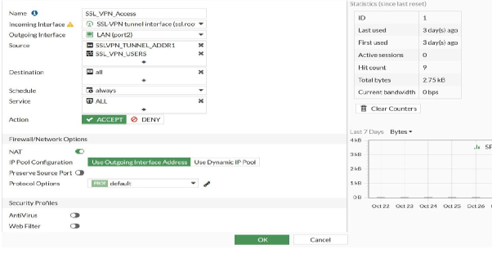
HQ FortiGate SSL VPN Configuration
Step 5: Firewall Policy Configuration
• Name: SSL_VPN_Access
• Incoming Interface: SSL VPN tunnel interface (ssl.root)
• Outgoing Interface: LAN (port2)
• Source: SSLVPN_TUNNEL_ADDR1
• Destination: All
• Schedule: Always
• Service: All
• Action: ACCEPT
• NAT: Enabled (Use Outgoing Interface Address)
Page 2

Slide 11
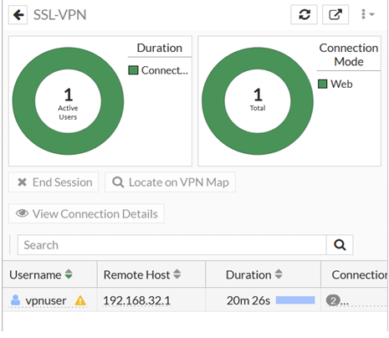
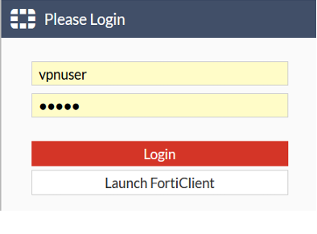
HQ FortiGate SSL VPN Configuration
Step 6: Web-Based Mode Testing
• SSL VPN portal accessible at https://192.168.32.135:10443
• FortiClient launch and download options available
• Verify login as vpnuser and check active connections on FortiGate Dashboard →
Network
Page 2

Slide 12
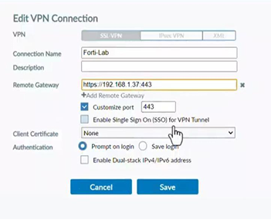
HQ FortiGate SSL VPN Configuration
Step 7: Tunnel Mode Testing
• VPN Name: <Specify>
• Connection Type: SSL-VPN
• Remote Gateway: https://<IP>:10443
• Port: 10443
• Authentication: Username/Password
• Dual-stack IPv4/IPv6: Enabled
Page 2

Slide 13
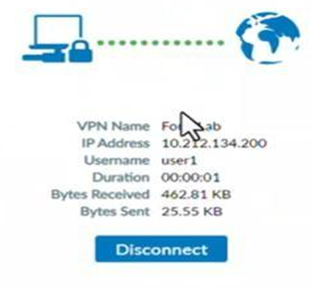
HQ FortiGate SSL VPN Configuration
Step 8: Connection and Monitoring
n this step, after establishing the connection using tunnel mode, I selected Forti-Lab
and tested the setup using the VPN user I had previously created.
As shown in the image, the monitoring interface displays several key details for each
connected user:
1. Username – identifies the authenticated VPN user.
2. IP Address – shows the assigned IP for the VPN session.
3. Connection Duration – indicates how long the user has been connected.
4. Bytes Sent and Received – displays the amount of data transmitted during
Page 2

Slide 14
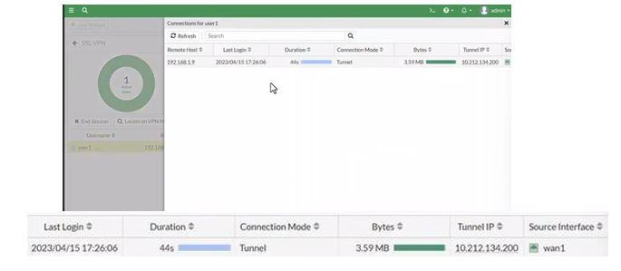
HQ FortiGate SSL VPN Configuration
Step 9: Monitoring & Active Connections:
Dash Board Shows :
• Displays: Username, IP, Connection Duration, Bytes Sent/Received
• Active Users: 1
• Connection Mode: Web
• Username: vpnuser
• Remote Host: 192.168.1.9
• Tunnel Ip: 10.212.134.200
• Duration: 44s
• Source interface: Wan1
• Tunnel IP: Assigned from SSLVPN_TUNNEL_ADDR1 pool
Page 2

Slide 15
IPsec VPN Configuration Documentation
Page 2

Slide 16
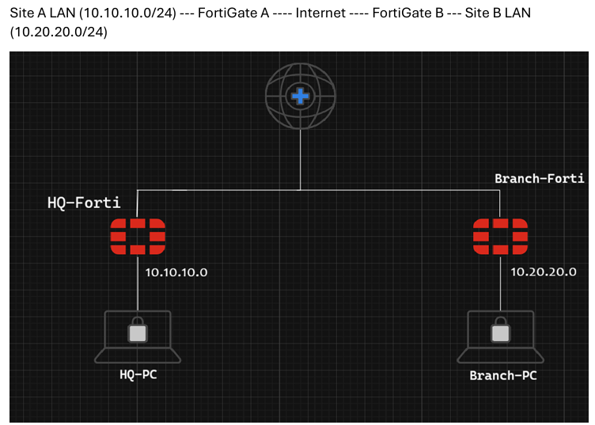
Network Topology
• Two FortiGate firewalls were used to connect two different LAN networks through the internet using an IPsecVPN tunnel.
• Each FortiGate represents a branch office / Headquarter office.
Page 2

Slide 17
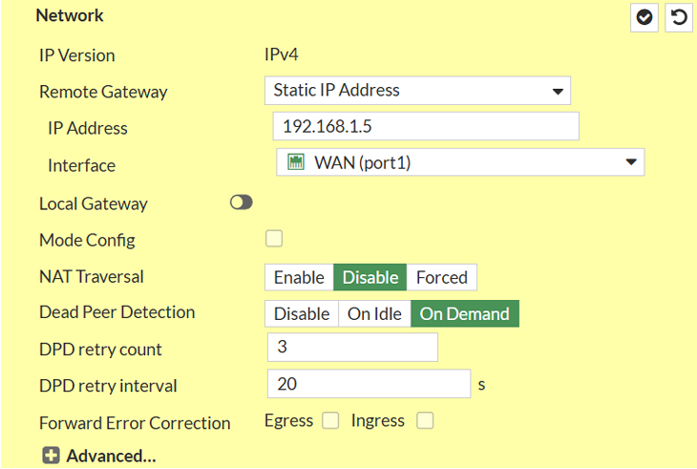
HQ FortiGate Configuration
Step 1: Phase 1 Configuration
Page 2

Slide 18
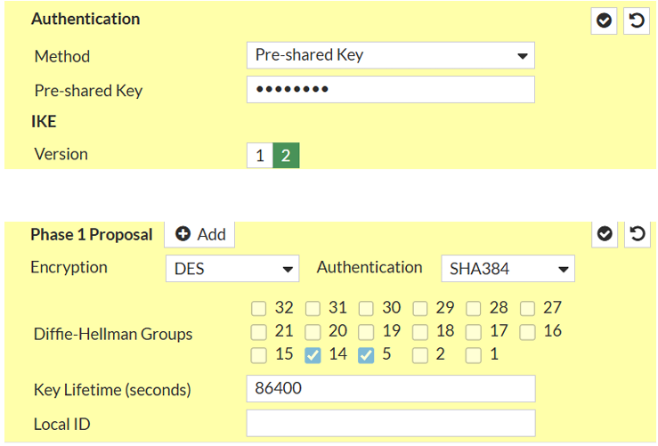
HQ FortiGate Configuration
Step 1: Phase 1 Configuration
Page 2

Slide 19
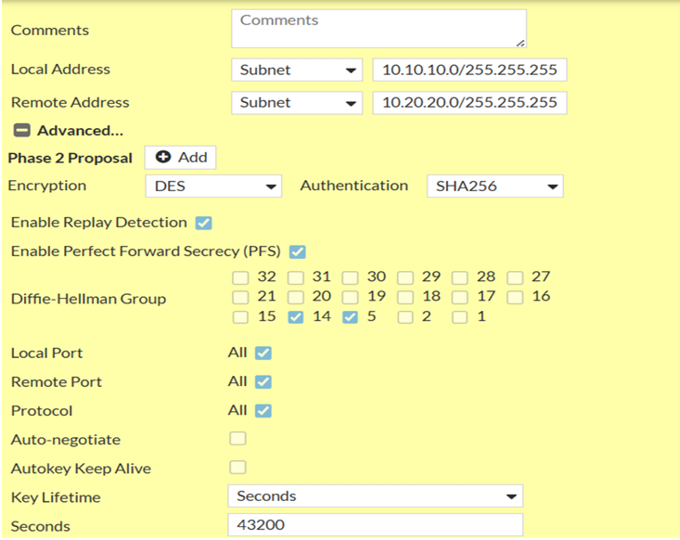
HQ FortiGate Configuration
Step 2: Phase 2 Configuration
Page 2

Slide 20
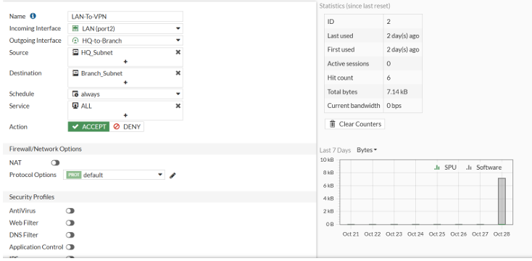
HQ FortiGate Configuration
Step 3: Firewall Policies
LAN-To-VPN
Page 2

Slide 21
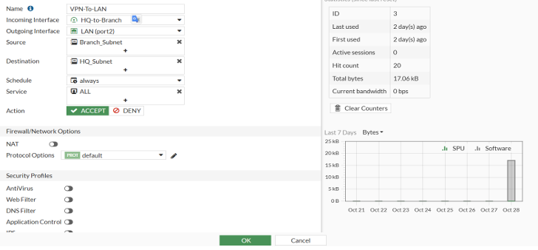
HQ FortiGate Configuration
Step 3: Firewall Policies
VPN-to-LAN
Page 2

Slide 22
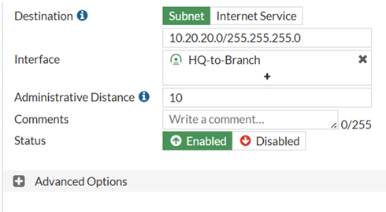
HQ FortiGate Configuration
Step 4: Static Routes
Add static routes to reach the remote subnet through the VPN tunnel.
Page 2

Slide 23
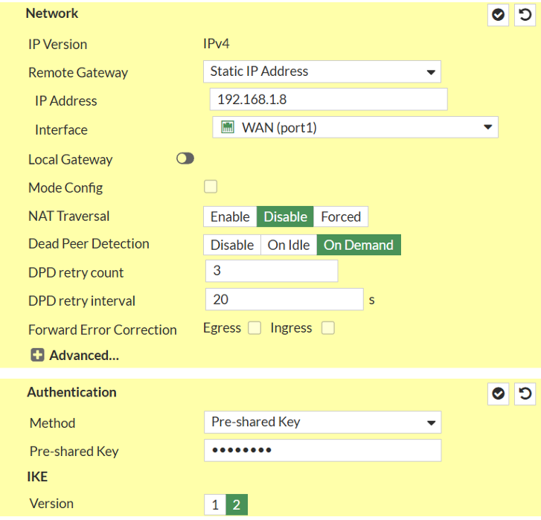
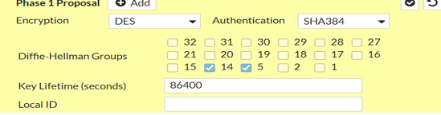
Branch FortiGate Configuration
Step 1: Phase 1 Configuration
Page 2

Slide 24
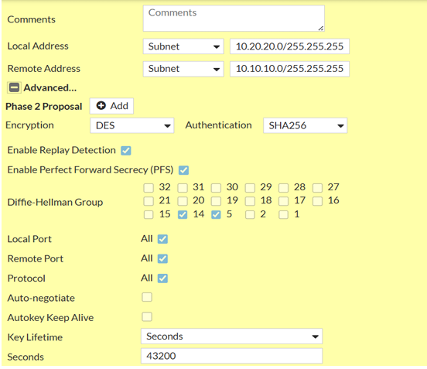
Branch FortiGate Configuration
Step 2: Phase 2 Configuration
Page 2

Slide 25
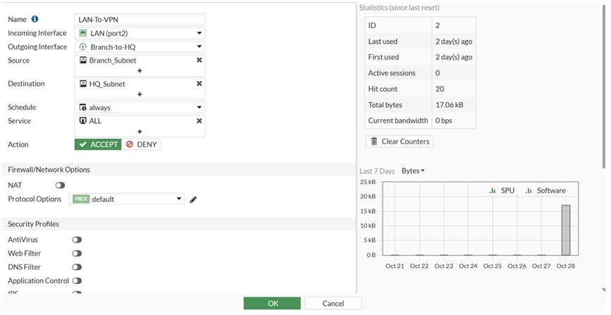
Branch FortiGate Configuration
Step 3: Firewall Policies
LAN-To-VPN
Page 2

Slide 26
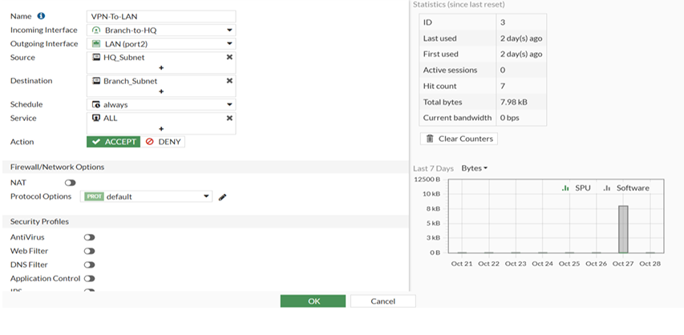
Branch FortiGate Configuration
Step 3: Firewall Policies
VPN-to-LAN
Page 2

Slide 27
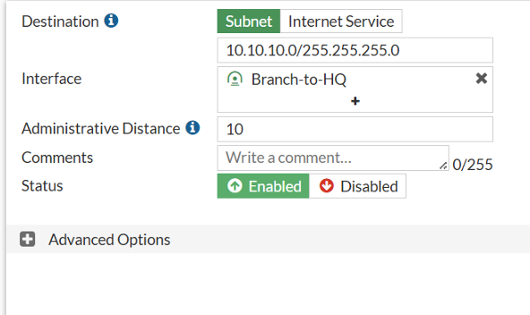
Branch FortiGate Configuration
Step 4: Static Routes
Add static routes to reach the remote subnet through the VPN tunnel.
Page 2

Slide 28
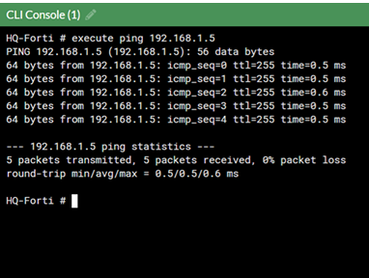
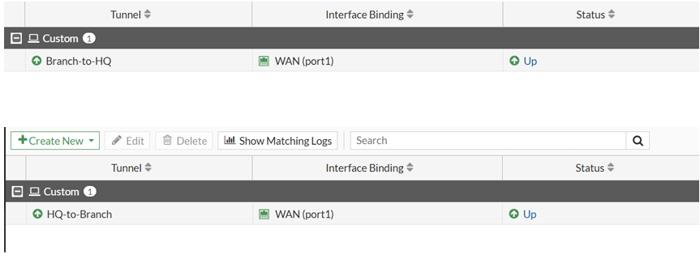
Connectivity Test Results
Test 1: Ping Test Between Branches
Page 2

Slide 29
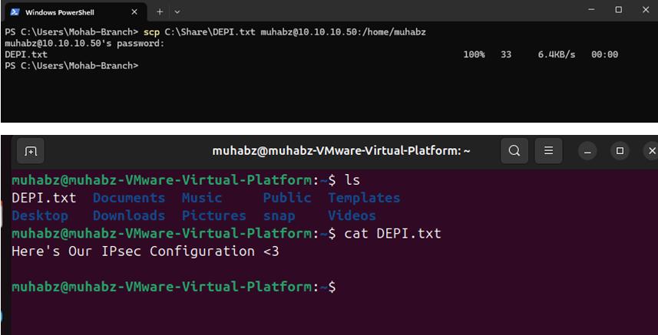
Connectivity Test Results
Test 2: File Transfer Test (SCP Protocol)
Page 2

Slide 30

THYNK UNKIMITED
BASIC PARTS OF A COMPUTER
Input Device
(Keyboard, Mouse)
Output Device
(Printer, Monitor)
Storage Device
(HDD, SSD)
A presentation is a formal talk, often delivered in front of an audience, aimed at conveying information, persuading others, or sharing insights on a particular topic.
Page 5

Slide 31
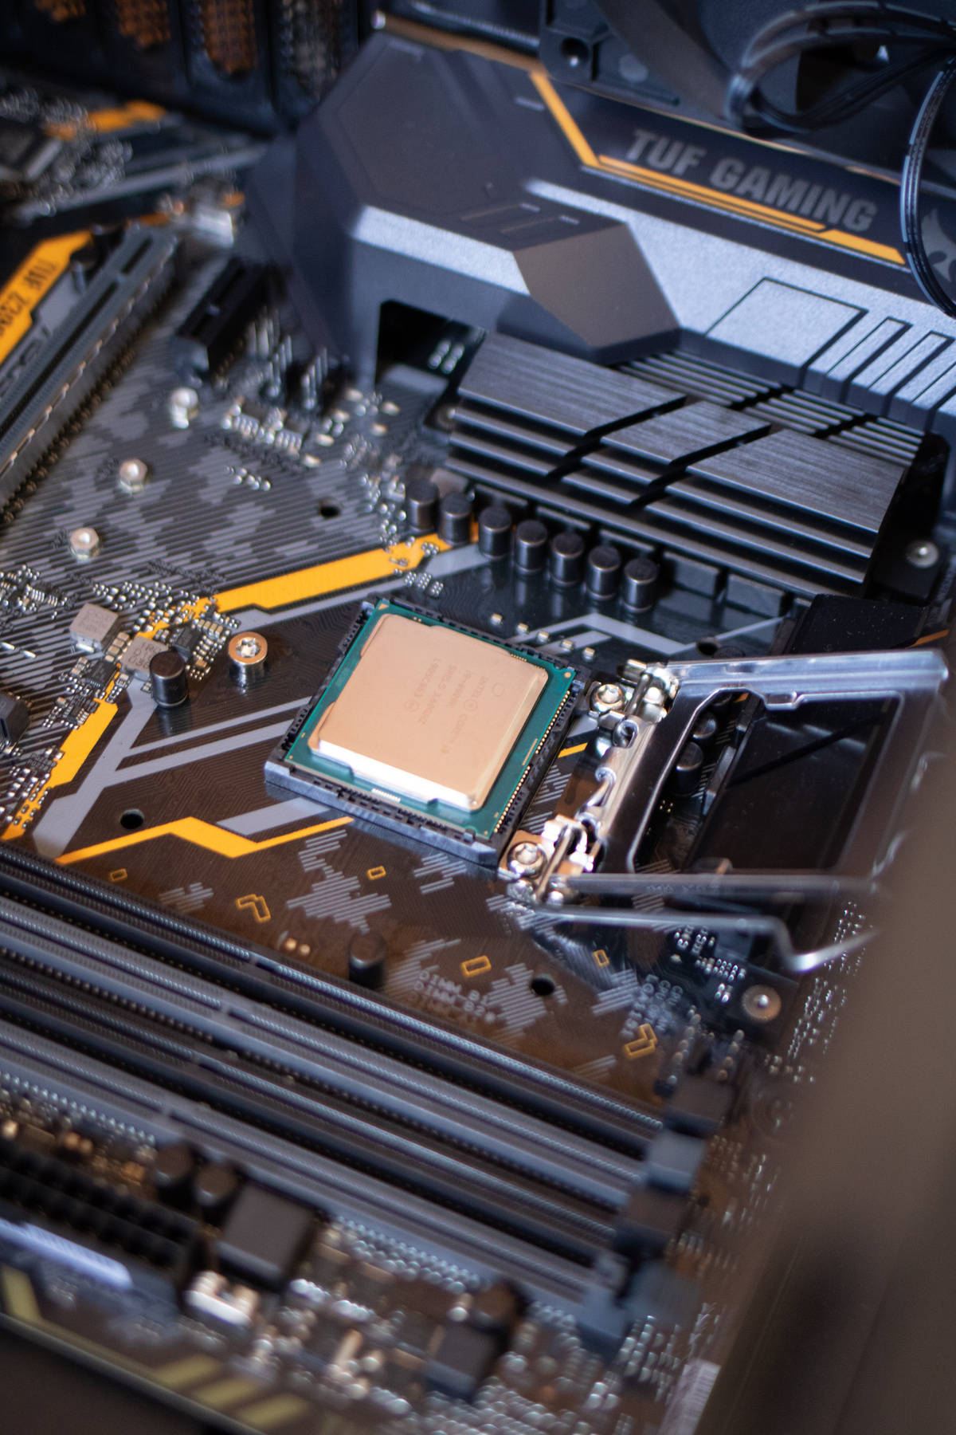
THYNK UNKIMITED
CENTRAL
PROCESSING UNIT (CPU)
A presentation is a formal talk, often delivered in front of an audience, aimed at conveying information, persuading others, or sharing insights on a particular topic. Presentations can take various forms, such as verbal speeches, slideshows, demonstrations, or multimedia displays. They are commonly used in academic, professional, and social settings to communicate ideas, proposals, reports, or findings.
Page 6

Slide 32
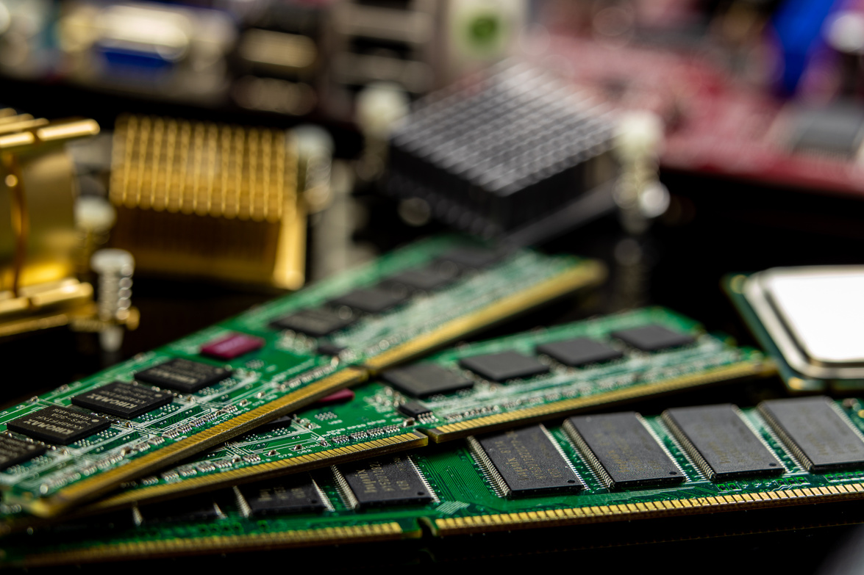
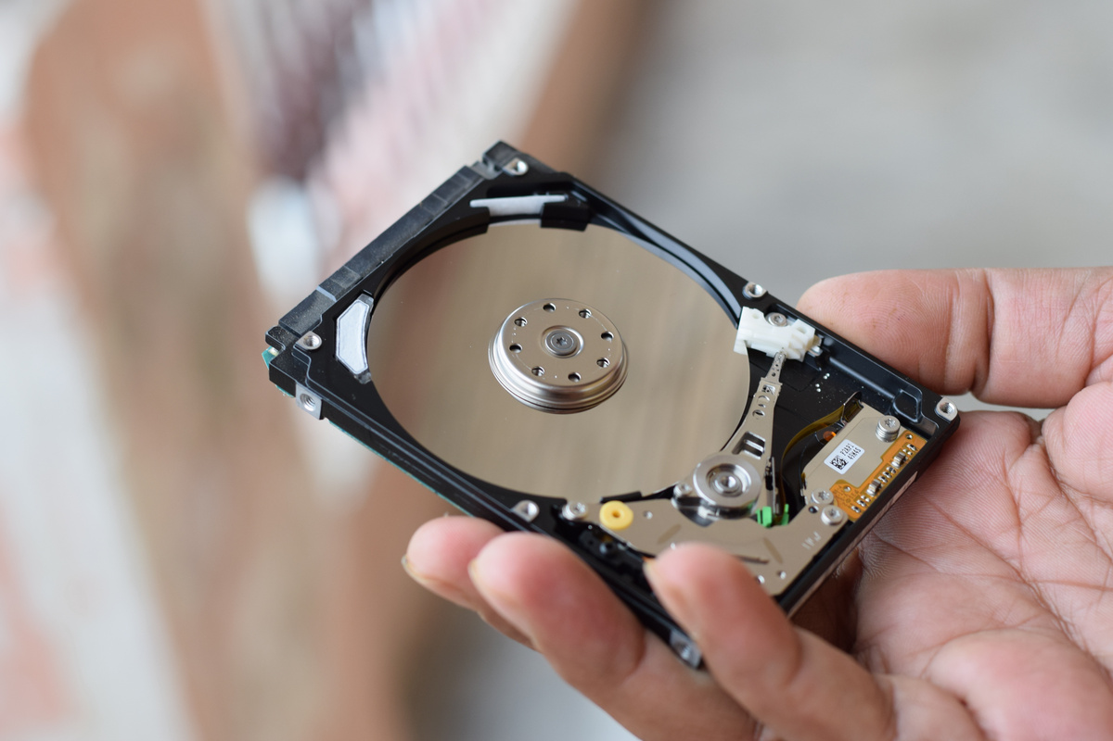

THYNK UNKIMITED
RAM & ROM
MEMORY & STORAGE
A presentation is a formal talk, often delivered in front of an audience, aimed at conveying information, persuading others, or sharing insights on a particular topic.
HDD & SSD
A presentation is a formal talk, often delivered in front of an audience, aimed at conveying information, persuading others, or sharing insights on a particular topic.
A presentation is a formal talk, often delivered in front of an audience, aimed at conveying information, persuading others, or sharing insights on a particular topic. Presentations can take various forms, such as verbal speeches, slideshows, demonstrations, or multimedia displays. They are commonly used in academic, professional, and social settings to communicate ideas, proposals, reports, or findings.
CLOUD STORAGE
A presentation is a formal talk, often delivered in front of an audience, aimed at conveying information, persuading others, or sharing insights on a particular topic.
Page 7

Slide 33

THYNK UNKIMITED
OPERATING SYSTEM (OS)
A presentation is a formal talk, often delivered in front of an audience, aimed at conveying information, persuading others, or sharing insights on a particular topic. Presentations can take various forms, such as verbal speeches, slideshows, demonstrations, or multimedia displays. They are commonly used in academic, professional, and social settings to communicate ideas, proposals, reports, or findings.
20K+
Rimberio User
33K+
Borcelle User
Page 8

Slide 34
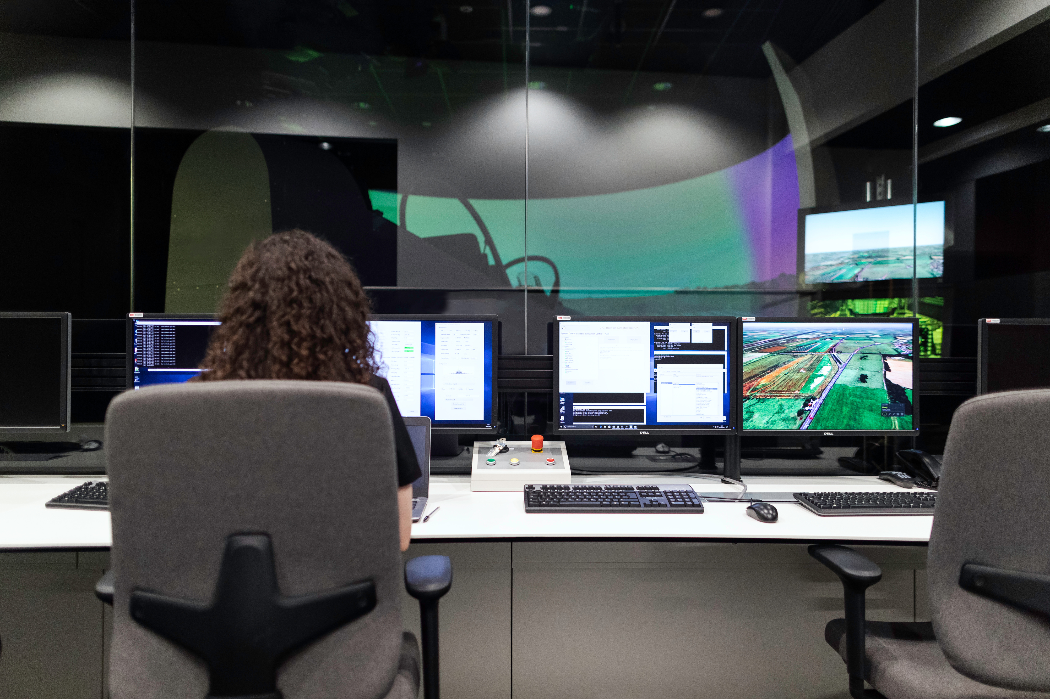
THYNK UNKIMITED
SOFTWARE & APPLICATION
Software
Application
A presentation is a formal talk, often delivered in front of an audience, aimed at conveying information, persuading others, or sharing insights on a particular topic. Presentations can take various forms, such as verbal speeches, slideshows, demonstrations, or multimedia displays.
A presentation is a formal talk, often delivered in front of an audience, aimed at conveying information, persuading others, or sharing insights on a particular topic. Presentations can take various forms, such as verbal speeches, slideshows, demonstrations, or multimedia displays.
Page 9

Slide 35

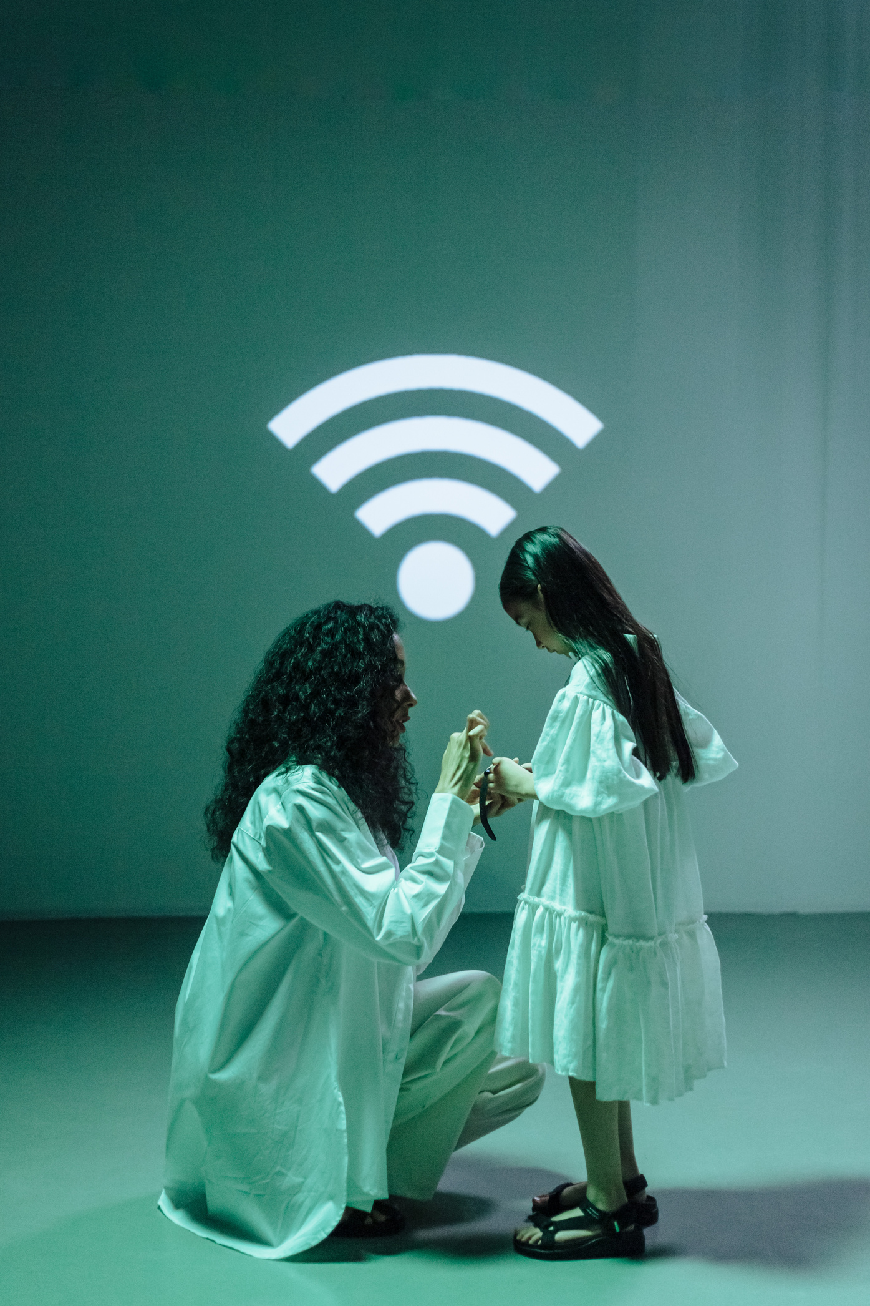
THYNK UNKIMITED
NETWORKING AND THE WEB
A presentation is a formal talk, often delivered in front of an audience, aimed at conveying information, persuading others, or sharing insights on a particular topic. Presentations can take various forms, such as verbal speeches, slideshows, demonstrations, or multimedia displays. They are commonly used in academic, professional, and social settings to communicate ideas, proposals, reports, or findings.
Effective presentations typically involve careful planning, organization, and delivery techniques to engage the audience and effectively convey the intended message.
Page 10

Slide 36

THYNK UNKIMITED
FUTURE OF COMPUTER
A presentation is a formal talk, often delivered in front of an audience, aimed at conveying information, persuading others, or sharing insights on a particular topic. Presentations can take various forms, such as verbal speeches, slideshows, demonstrations, or multimedia displays. They are commonly used in academic, professional, and social settings to communicate ideas, proposals, reports, or findings.
Effective presentations typically involve careful planning, organization, and delivery techniques to engage the audience and effectively convey the intended message.
Learn More
Page 11

Slide 37



THYNK UNKIMITED
THANK YOU
+123-456-7890
WWW.REALLYGREATSITE.COM
123 ANYWHERE ST., ANY CITY
Page 12

